Slide 1
ELK STACK

Slide 2
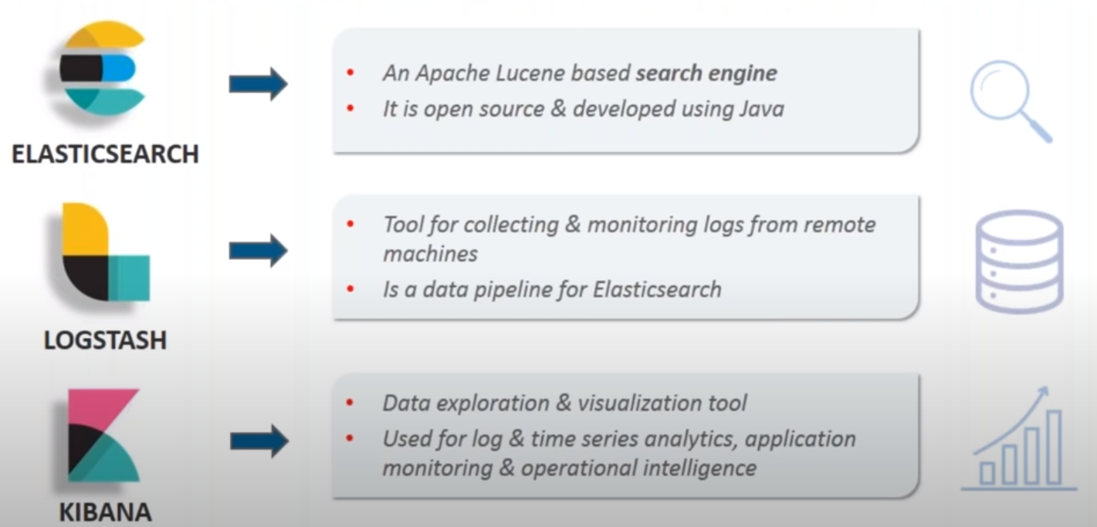
ELK Stack: is a combination of 3 open-source tools for log analysis.

Slide 3
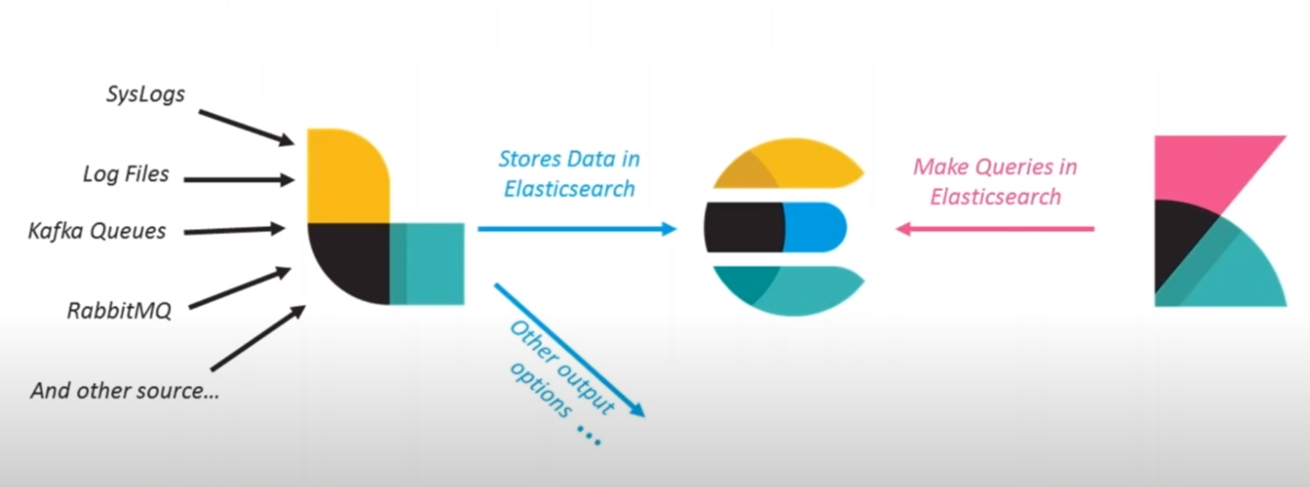
How Do They Work Together?

Slide 4
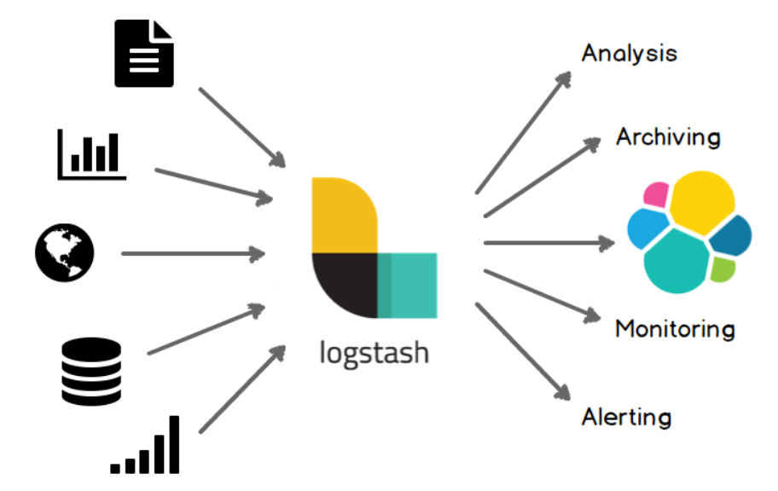
Logstash
Logstash is an open source data collection engine with real-time pipelining capabilities. Logstash can dynamically unify data from disparate sources and normalize the data into destinations of your choice.
While Logstash originally drove innovation in log collection, its capabilities extend well beyond that use case. Any type of event can be enriched and transformed with a broad array of input, filter, and output plugins, with many native codecs further simplifying the ingestion process.

Slide 5
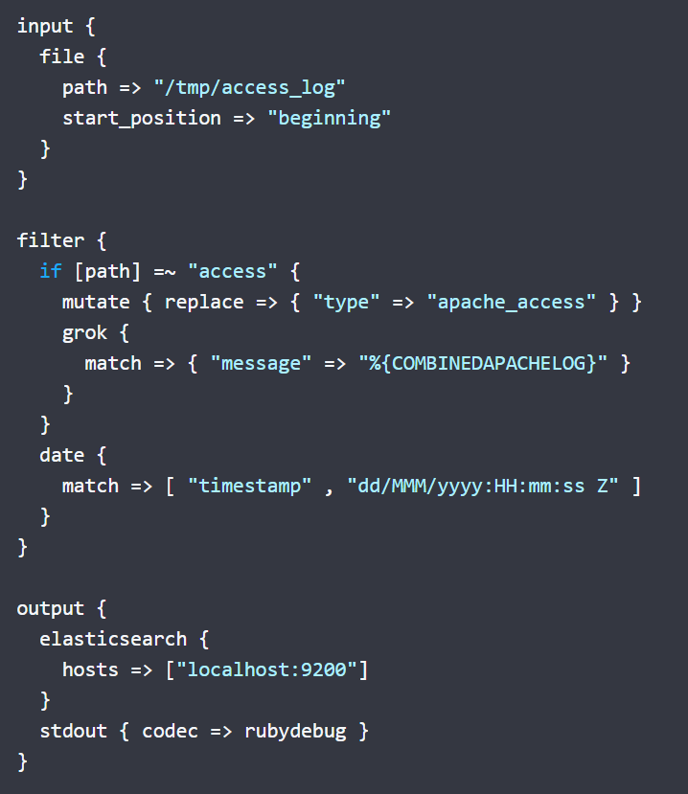
How Logstash Works
The Logstash event processing pipeline has three stages: inputs → filters → outputs. Inputs generate events, filters modify them, and outputs ship them elsewhere. Inputs and outputs support codecs that enable you to encode or decode the data as it enters or exits the pipeline without having to use a separate filter.
Input/Filter/Output plugins https://www.elastic.co/guide/en/logstash/current/input-plugins.html /filter-plugins.html /output-plugins.html

Slide 6
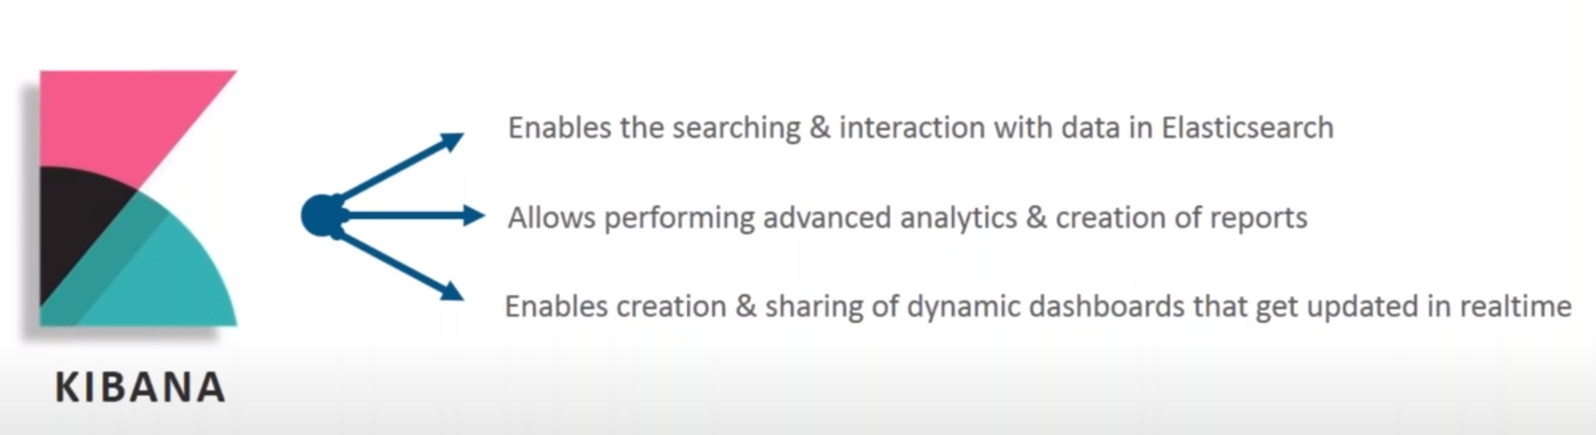
Role of KIBANA in ELK

Slide 7
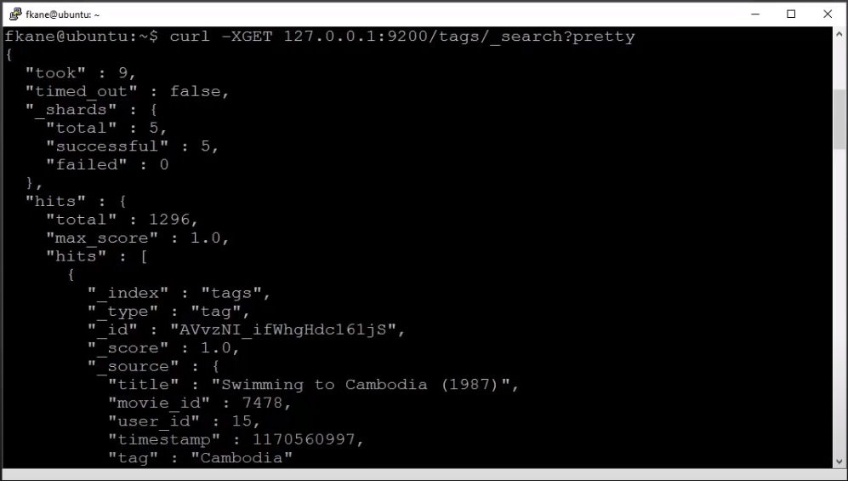
Elasticsearch Nedir?
Elasticsearch, metinsel, sayısal, coğrafik, yapılandırılmış ve yapılandırılmamış her tür veri için dağıtılmış, açık kaynaklı bir arama ve analitik motorudur. Restful servisler ile çalışır. Ölçeklendirmesi mimarisinden kaynaklı kolaydır.
Basit tabirler ile, belge odaklı (document-based) ve yarı yapılandırılmış verileri depolayan ve yöneten bir veritabanıdır.

Slide 8
Elasticsearch Neden Kullanılmalıdır?
E-ticareti ve büyük veritabanlarına sahip arama motorlarını içeren ürünler, çok uzun süren ürün bilgilerinin alınması da dahil olmak üzere sorunlarla karşı karşıyadır. Bu, kötü kullanıcı deneyimine yol açar ve dolayısıyla potansiyel müşterileri kapatır.
Aramada ayrıca, ürün tasarımı için kullanılan ilişkisel veritabanına atfedilen bir gecikme vardır; burada veriler birden çok tablo arasında dağılmıştır ve anlamlı kullanıcı bilgilerinin başarılı bir şekilde alınması, verilerin bu tablolardan alınmasını gerektirir.
İlişkisel veritabanı, çok büyük veriler söz konusu olduğunda ve veritabanı sorguları aracılığıyla arama sonuçlarını getirirken nispeten yavaş çalışır
Eğer büyük veri blokları arasında metin arama (full text search) gibi bir ihtiyacımız varsa, bu durumda Elasticsearch bizim için doğru bir tercih olabilir.Genellikle Hadoop / Spark / Flink vs.'den daha hızlı bir çözümdür.

Slide 9
Elasticsearch is used for?
Application search
Website search
Logging and log analytics
Geospatial data analysis and visualization
Business analytics
Much more….

Slide 10
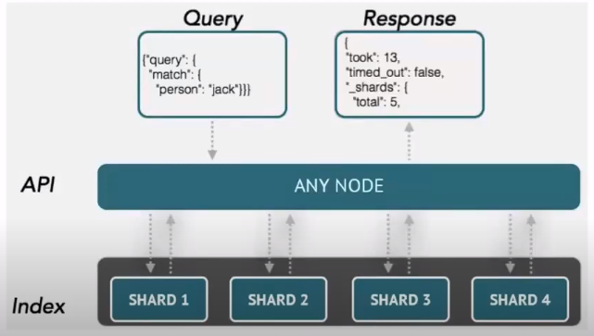
How Elasticsearch works
Raw data flows into Elasticsearch from variety of sources, including logs, system metrics and web applications.
Data ingestion is the process by which this raw data is parsed, normalized, and enriched before it is indexed in Elasticsearch.
Once indexed in Elasticsearch, users can run complex queries against their data and use aggregations to retrieve complex summaries of their data.
From Kibana, users can create powerful visualizations of their data, share dashboards, and manage the Elastic Stack.

Slide 11
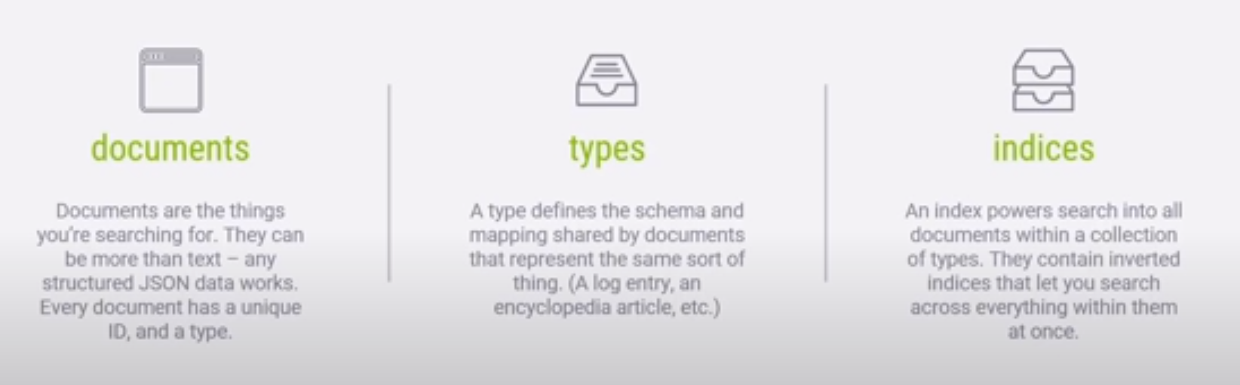
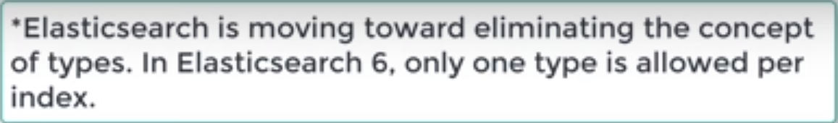
Logical Concepts of Elasticsearch

Slide 12

What is an inverted index

Slide 13
Basic Concepts of Elasticsearch
Cluster : is a collection of one ore more servers that together hold entire data and give federated indexing and search capabilities across all servers. For relational databases, the node is DB instance. There can be N nodes with the same cluster name.
Node: A node is a single server that holds some data and participates on the cluster’s indexing and querying. A node can be configured to join a specific cluster by the particular cluster name. A single cluster can have as many nodes as we want. A node is simply one Elasticsearch instance.
.

Slide 14
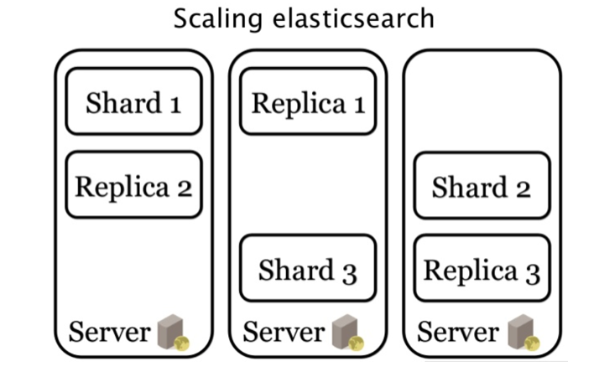
Basic Concepts of Elasticsearch(Cont.)
Index: The index is a collection of documents that have similar characteristics.
Shard: A shard is a subset of documents of an index. An index can be divided into many shards.
Replica: There is a replica-shard structure that allows one or more copies of index shards to be created in case the shard becomes disabled

Slide 15
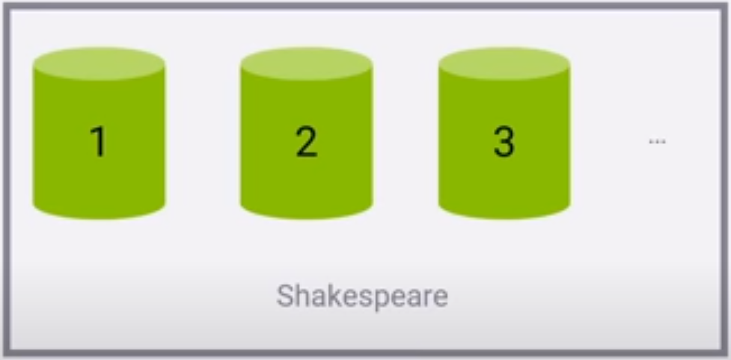
How Elasticsearch scales
An index is split into shards.
Documents are hashed to a particular shard.
Each shard may be on a different node in a cluster.
Every shard is a self-contained Lucene index of its own.

Slide 16
Elasticsearch REST APIs
Index(PUT/POST) API: It helps to add or update the JSON document in an index when a request is made to that respective index with specific mapping
GET API: It helps to extract type JSON object by performing a get request for a particular document.
DELETE API: You can delete a particular index, mapping or a document by sending a HTTP DELETE request to Elasticsearch.
UPDATE API: Update the docs/data put into elasticsearch.
BULK API: If you have a lot of documents to index, you can submit them in batches with the bulk API. Using bulk to batch document operations is significantly faster than submitting requests individually as it minimizes network roundtrips.

